Slide 1
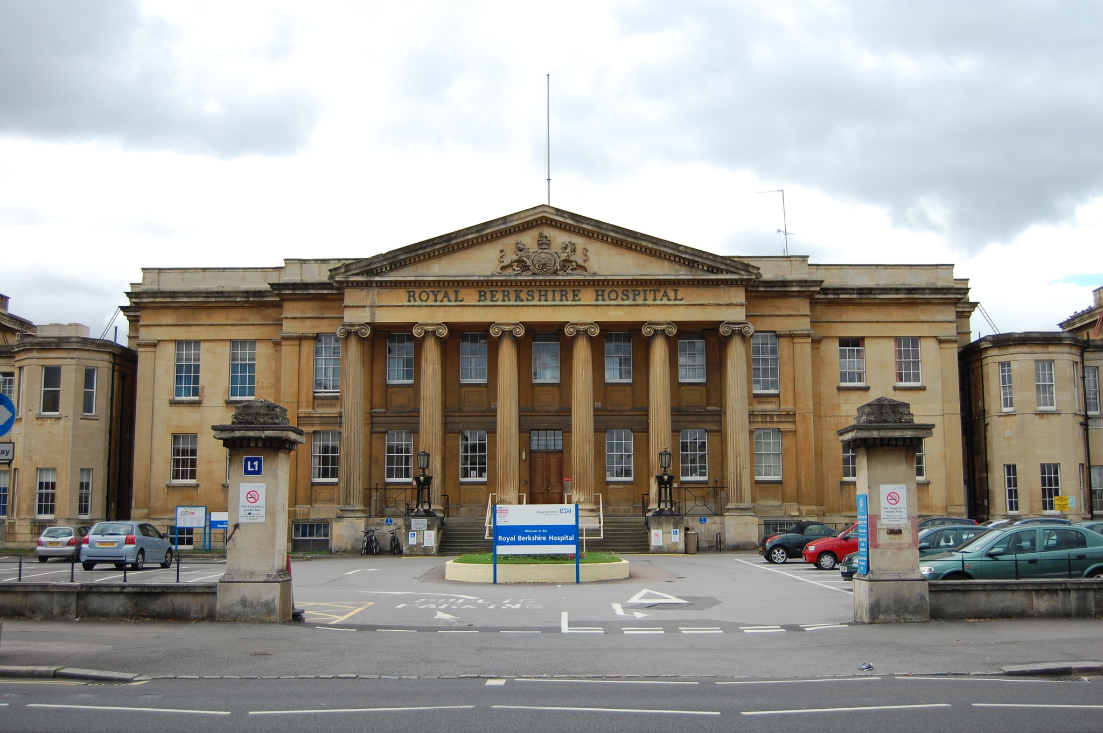
SIAs at RBH 5th Sept 2022 Jon Mayer Simon Coleman

Slide 2
SIA
During Stage 3, 12m (WTE)
Develop capability to be an independent practitioner (by end of stage 3 i.e supervision level 4)
Prepare to practice in areas that you may want to as a consultant
6m - 1 year at RBH (various combinations possible: 1 from group 1 and up to 2 from group 2; up to 3 from group 2)
Please let TPD (Dr Sara McDouall) and Dr Ruth Webster know your SIAs preferences are ASAP!

Slide 3
Currently 7 SIAs on offer at RBH:
POM – Dr Jennie Rechner (6m)
Major general – Dr Richard Barnes (3m ?)
Complex Airway – Dr Ed Todman and Dr Jon Mayer (3-6m)
Regional – Dr Julie Kuzhively and Dr Kelly Place (3-6m)
Pain – Dr Deepak Ravindran and Dr Ram Dhotarkar (6m)
Obstetrics (Group 1) – Dr Lauren Williams (3-6m)
Bariatrics – Dr Simon Coleman (6m)
n.b. All are ’Group 2’ SIAs except obs thus are 3-6 months modules

Slide 4
RBH
Busy DGH with excellent on call exposure to prepare for solo consultant working
Remodelling of consultant on call to provide more bespoke training
Previous fellows have created a niche leading to consultant appoinment
Sim centre

Slide 5
SIA Perioperative Medicine

Slide 6
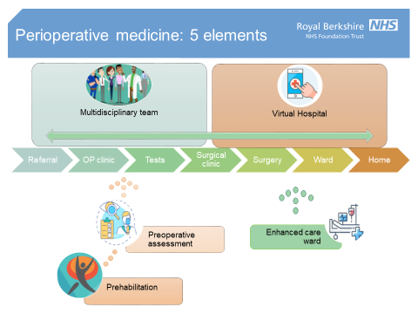
Why Reading?
Established senior fellow programme in POM since 2017
Trust strategic priority to develop a comprehensive perioperative medicine service.
Service to comprise:

Slide 7
Clinical capabilities
Preoperative assessment with established management of anaemia, OSA, anticoagulation, diabetes, hypertension, frailty, cognitive impairment
Surgical liaison service
Award winning ortho-geriatric service
Multidisciplinary high risk anaesthetic clinic in development
Fully digital service

Slide 8
Leadership capabilities
Work with new Clinical Director to establish a comprehensive POM service
Prehabilitation service in development- in partnership with technology companies, Oxford Academic Health Science Network and NHSx
Collaborative working with community service and Public Health
Develop skills and knowledge in Project Management and QI tools

Slide 9
SIA major general surgery

Slide 10
What Reading Offers
Nationally renowned robotic urology centre
~300 prostatectomies per year + regular cystectomy cases
High volume major general surgery
~200 elective colorectal resections per year
~200 emergency laparotomies per year
Major gynaecology
~75 hysterectomies per year
* Endocrine component of Module would need to be completed in Oxford

Slide 11
Opportunities
Involvement in pre-op assessment, risk discussion and risk reduction strategies with multi-disciplinary high-risk clinic in development
Development of clinical skills in the set-up, delivery of anaesthesia and post-op care for major elective surgical caseload
On-call for emergency theatre (rather than maternity)
Active research and national audit involvement – e.g. NELA, Allegro, PQIP, SNAP

Slide 12
SIA Complex Airway

Slide 13
Why Reading?
Three all day airway specific lists. Expanding and dynamic service.
Superb ENT team with areas of regional expertise in many areas.
Universal CMAC V-L across entire trust
Excellent teaching opportunities
National, regional and local
Fully digital hospital record

Slide 14
Clinical capabilities
Excellent exposure to wide range of airway related surgeries
Microlaryngscopies with CO2 laser/tumour debulk, VC injections, balloon dilation of subglottic stenoses, thyroids, parathyroids, tracheostomy
Referrals from all over the region and south east for endoscopic surgical treatment of swallowing problems e.g. laser endoscopic cricopharyngeal myotomy.
Provide airway expertise in regional thyroid MDT. Take referrals from Oxford for endoscopic management of tracheal tumour invasion
Diagnostic and Oncology treatment centre for Head and Neck cancer. Offer remedial surgery for post treatment of cancer patients
? Tracheal resection work / more voice work coming in October 22..
Trainee will be competent at jet ventilation by end of post (supra and infraglottic with Monsoon)
+ Use of apnoeic techniques HFNO, airway exchange and TIVA with BIS.

Slide 15
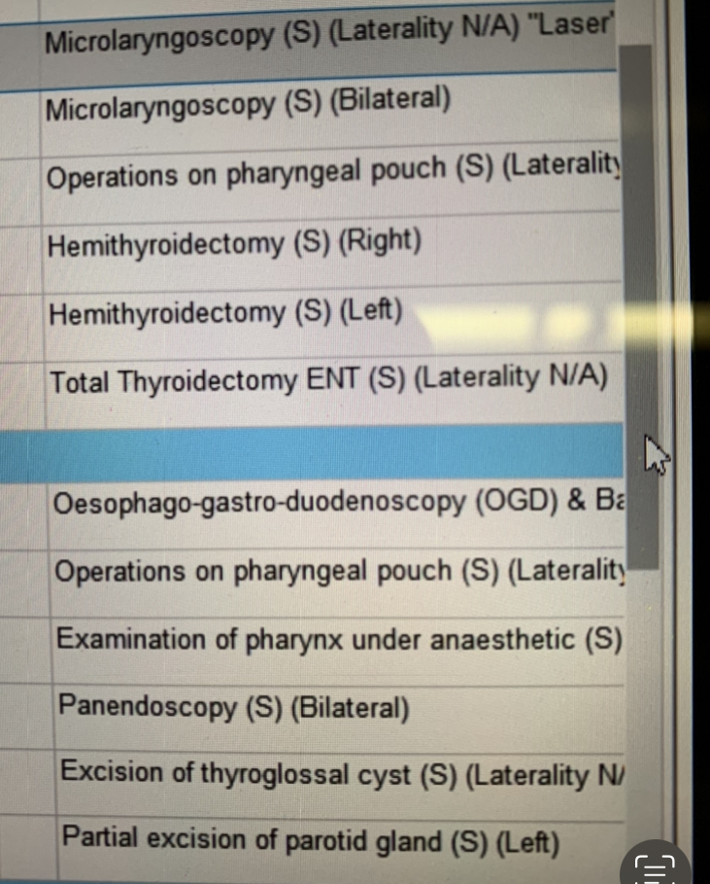
Clinical capabilities
2/9/22
Th 9 (JM):
Th 10 (SC):

Slide 16
Clinical capabilities
Weekly Tracheostomy MDT + regional Head &Neck and Thyroid MDTs
Other surgical specialities on site requiring regular airway input
Bariatrics, dental (adult and paeds)
Orthopaedics – cervical spine stabilisations/fusions
Awake Tracheal Intubation skills
scope handling skills via ORSIM
FNE training in ENT clinic with very supportive ENT department.
awake VL techniques
Multiple opportunities for awake intubations plus asleep scope guided intubations

Slide 17
Training and Leadership capabilities
Opportunities to attend and teach on National airway management courses (eg Faculty at RCOA airway day, GAMC)
Local training/ teaching
ORSIM
Fibre-optic training days
ODP Co-pilot training day
FONA training
Partnership with JR
Major complications of airway management project
Participate and contribute to Regional Airway M&M

Slide 18
SIA Pain

Slide 19
Pain Medicine at RBH
Pain department delivers both acute and chronic pain service.
Department has own outpatient offices and procedure room (not affected by theatre space).
Comprehensive department with 5 pain consultants (3 full time), 5 specialist nurses, 3 in house specialist physiotherapists and 2 psychologists and separate admin team.
We offer a wide range of interventions done by a standard DGH including USG procedures. We also work with palliative care teams locally for providing cancer pain interventional experience and also act as referral hub for the UCL tertiary service of Intrathecal service.

Slide 20
Pain Medicine at RBH special aspects-
Integrated
We are integrated with the award winning community services (IPASS) and also with GP/Primary care networks (PCN) and so are able to offer the trainee a comprehensive experience both in hospital and at community level.
Research active
We are an active pain research centre with an option to get involved in research at the University and QI projects both in prehab and pain management.
Transitional pain service - unique integration
We have a fully developed TPS and links with prehabilitation and perioperative care and introducing digital technologies as well.
“My pain” We are the first service in the UK to offer an entirely digital pain management programme for selected cohorts of patients and trainees have an option to explore such a programme.

Slide 21
Pain Medicine at RBH special aspects-
Long COVID
Only pain service in the country to also run a Long covid service so trainees get a chance to be part of that service and gain experience.
Excellent opportunity for non clinical SIAs
Dr Ravindran is the clinical lead who has a dual degree in management and systems leadership. Trainees have good opportunity to understand the long term vision of the NHS and also management/leadership support/understanding.
Technology
We use digital platforms for patient records, radiology , Phillips dictation systems for faster processing of clinic letters- full integration with EPR.

Slide 22
SIA Regional

Slide 23
Clinical opportunities
Reading is home to the Reading shoulder unit with 2 dedicated elective and trauma consultants allowing several lists per week with regional opportunities
The hand unit is a run by two dedicated hand surgeons allowing brachial plexus, Biers and peripheral nerve blocks.
Adductor canal blocks are used for enhanced recovery knees
Dual trauma lists running daily allowing a range of trauma blocks including fascia iliaca and popliteal
Easy access to Ultrasound with regular scanning of spines on the consultant led elective section lists
DOI: minimal catheter techniques, developing trunk and chest blocks as above

Slide 24
QI opportunities
Promotion of regional techniques at pre and perioperative setting
Promoting regional techniques in wards for trauma – fractured neck of femur and ribs (major ESP pathway project underway)
Promotion and education of theatre and non theatre block areas
Block room feasibility study
Business case- expand USS sim facilities and services eg PECS block for breast surgery

Slide 25
SIA Obstetrics

Slide 26
RBHFT Maternity services
Busy District General Hospital
4800 deliveries per yr
Increasing acuity - mat age, BMI, diabetes, co-morbidities
40% CS rate (from 30%)
Consultant delivered anaesthetic care 8-8 weekdays plus 8-5 weekend
Dedicated elective CS list every weekday. Plan to expand into pm.
High risk antenatal anaesthetic clinic & cardiac antenatal clinic– MDT delivery planning
ROTEM
Fully digital EPR – Cerner Obstetrics view and SAAnaesthesia

Slide 27
Leadership opportunities
Faculty / anaesthetic lead for MDT training
PROMPT plus weekly in situ skills drills
Develop, organise and evaluate ongoing multidisciplinary drills training in light of Ockendon review
IACOA training – dedicated morning every week
Guideline review and development
Intrapartum forum meeting, Obstetric clinical governance, BOBS LMNS Quality & Safety forum

Slide 28
QI opportunities
Nitrous oxide mitigation + sustainability projects
Higher Monitoring Area Transformation project – incl midwife HDU training
Expanding elective CS list / theatre scheduling
Increasing cell saver availability

Slide 29
SIA Bariatrics

Slide 30
Bariatric SIA
Bariatric surgery
Estimated eligible population 9 million adults in UK
Paediatrics too
Est 7000 cases per year
Highly clinically effective
Highly cost effective
Bariatric anaesthesia
Challenging
Comorbidities
Proper MDT

Slide 31
Bariatrics at RBH
Regional centre: 200+ operations per year
Robotic surgery
Endoscopic surgery
5 surgeons, 4 anaesthetists
2-3 lists per week
MDT every fortnight weeks
SOBA/IFSO/BOMSS/Orleans/Bruges/Rotterdam
Alumni: Claire Seeley, Gopalan Radhakrishnan

Slide 32
Any Questions?

Slide 33
Module leads + wider faculty
POM – Dr Jennie Rechner (Jennie.Rechner@royalberkshire.nhs.uk) +Sara McDouall, Clare Seeley, Simon Tunstill, Doug Barker
Major general – Dr Richard Barnes (Richard.Barnes@royalberkshire.nhs.uk) + Ed Todman
Complex Airway – Dr Ed Todman (ed.todman@royalberkshire.nhs.uk) + Dr Jon Mayer and Simon Coleman
Regional – Dr Julie Kuzhively (julie.kuzhively@royalberkshire.nhs.uk) and Dr Kelly Place (kelly.place@royalberkshire.nhs.uk)
Pain – Dr Deepak Ravindran (deepak.ravindran@royalberkshire.nhs.uk) and Dr Ram Dhotarkar (ram.dhotarkar@royalberkshire.nhs.uk)
Obstetrics – Dr Lauren Williams (lauren.williams@royalberkshire.nhs.uk) + Sarah Williams, Guy Jackson
Bariatrics – Dr Simon Coleman (simon.coleman@royalberkshire.nhs.uk) + Clare Seeley, Gopal Radharkrishnan, Kate Paterson, Kim Soulsby

